Slide 1
Lecture 6 – Python(Lists)
By- Pratik Sanghvi

Slide 2
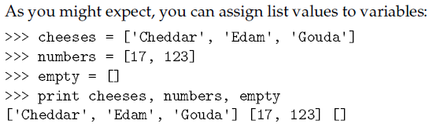
Values and accessing elements
List is a sequence of values
The values inside the list can be of any type, and the values inside are known as elements or items
List can be created by enclosing the values between square brackets E.g. A=[1,2,3]
A list within another list is called a nested list E.g. A=[1,2,[3,4]]
List elements can be accessed in a same way as strings E.g. A=[1,2], A[0]->1
Ex

Slide 3
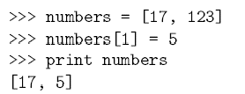
Lists are mutable
Unlike strings, the lists are mutable
It means that, a list once created can be modified with any objects
Also, we can change the list slices with any object
Each element in the list maps to one index which is helpful in accessing the list values
Ex

Slide 4
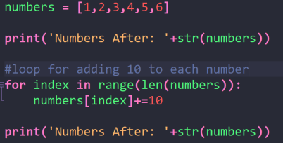
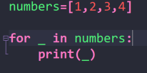

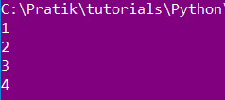


Traversing a list
List is a sequence of values which can be traversed using basic for loop. Ref: Ex1
If we want to change the elements of the list then we have to use the range() and len() function. Ref:Ex2
Iteration over empty list will not execute the loop body. Ref: Ex3
Example 1
Example 2
Example 3
Output 1
Output 2
Output 3

Slide 5
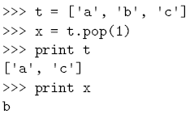

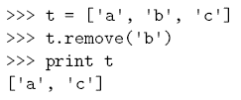
Deleting Elements from a list
If you know the list index to remove the element, then you can use pop(). Ref:Ex1
By default pop removes the last element from the list, if no index specified
Pop returns the value which was removed
If you do not want the removed value in return , the you can use del() Ref:Ex2
If you know the element which you want to remove, but not the index then remove() can be used Ref: Ex3
Ex 1
Ex 2
Ex 3

Slide 6
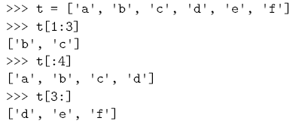
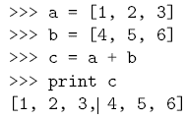


Built-in list operators, Concatenation, Repetition
The ‘+’ operator concatenates the list Ref: Ex1
The ‘*’ operator repeats the list given number of times Ref: Ex2
Slicing also works on list. We can specify the start and end index to extract a slice of a list. Ref: Ex3
We can change a subset of elements in the list by using slicing. Ref: Ex4
Ex1
Ex2
Ex3
Ex4

Slide 7
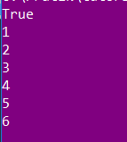
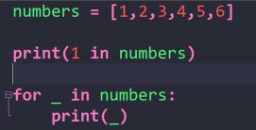
In operator
In operator is used as a membership operator to check the presence of a value in the list Ref: Ex1
It is also used to get the elements while iterating over a given list. Ref: Ex1
Ex1
Output

Slide 8
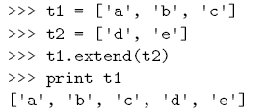
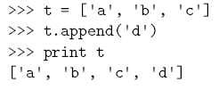
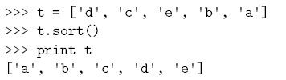

Built-in List functions and methods
Since lists are mutable we can change them inplace using methods
Append method adds the element to the referenced list Ref: Ex1
Extend takes a list as an argument an adds all the argument list element to the referenced list Ref: Ex2
Sort arranges the elements of the list from low to high. Ref: Ex3
Note: All the methods of the list returns None
Sum method can be used to reduce a list to a single value Ref: Ex4
Ex1
Ex2
Ex3
Ex4
Python List Methods Reference: LINK

